Slide 1

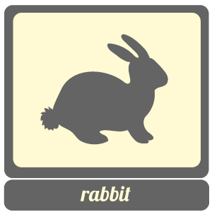
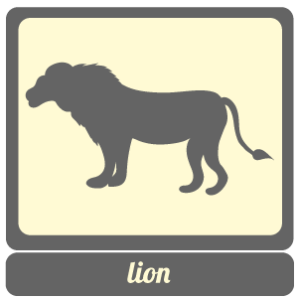

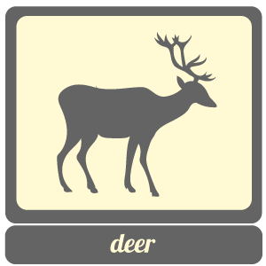
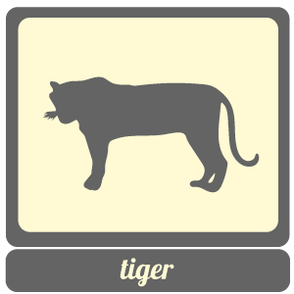
Food Chains Review
Food Chains
Food chains follow a single path as animals eat each other.
Do these animals live in the same habitat?
How do we show how animals in different food chains that are found in the same habitat are interconnected ?

Slide 2
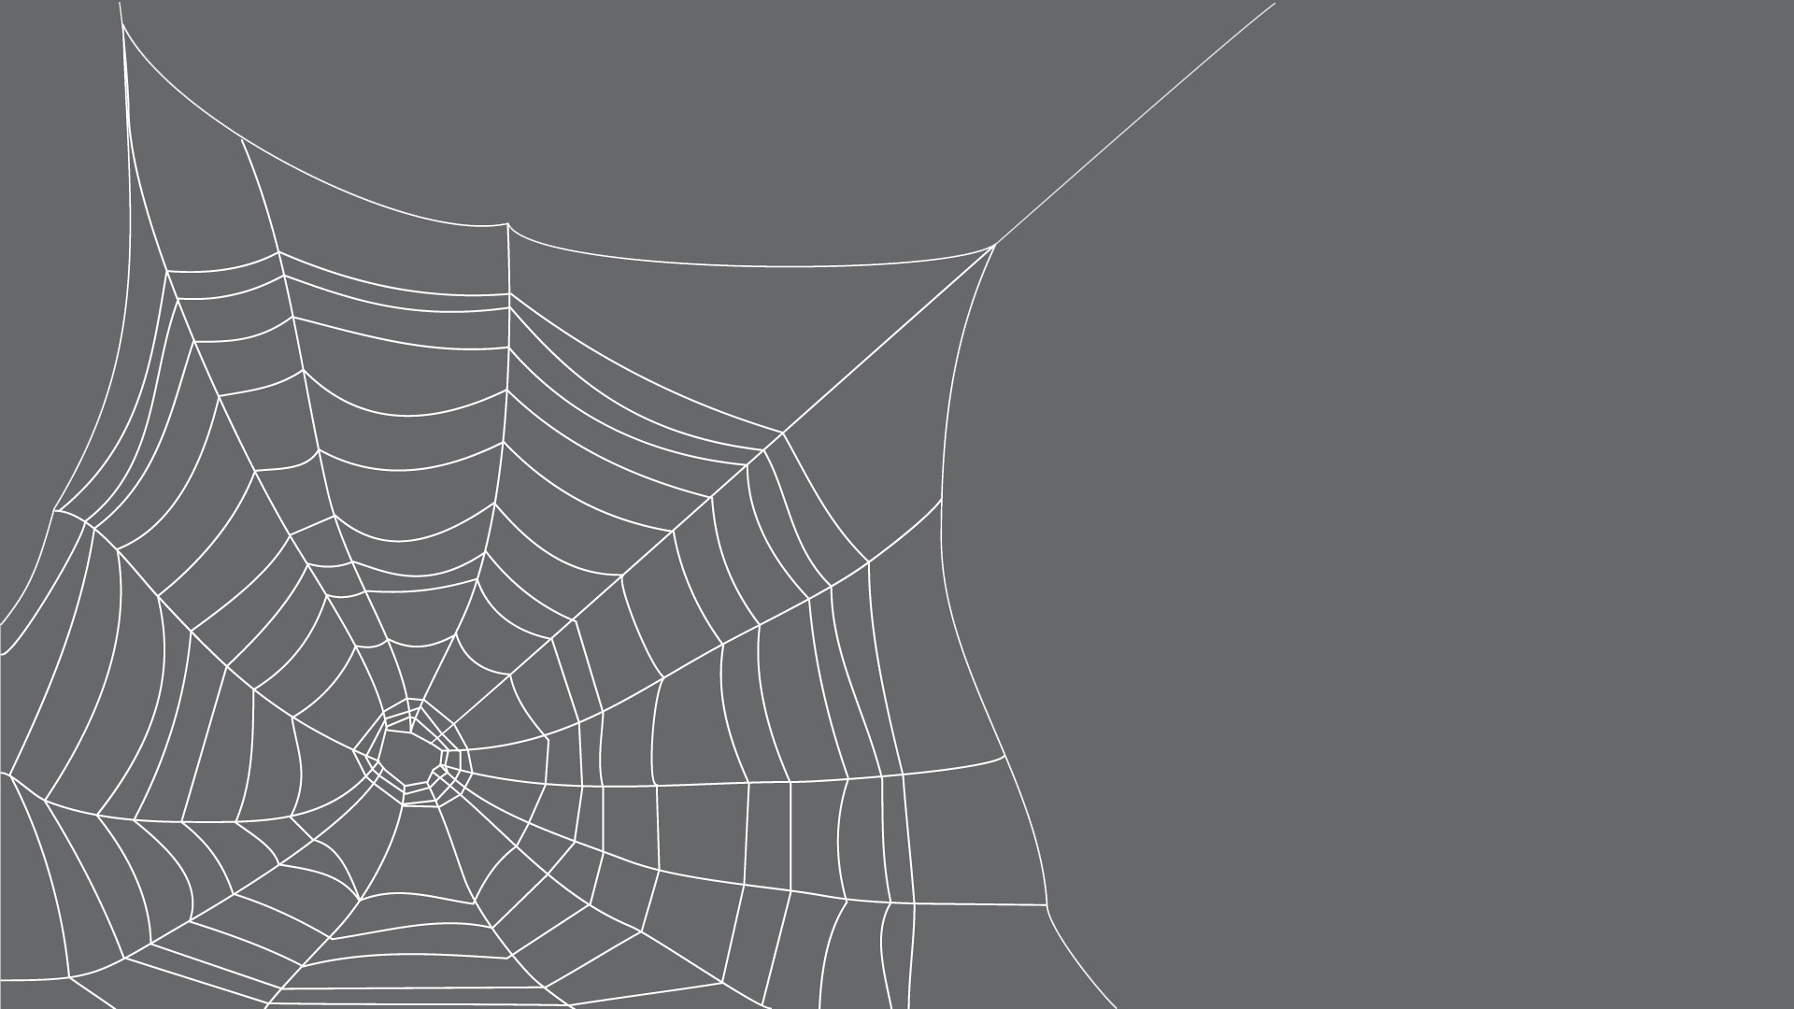
Nature’s Food Webs
NATURE’S FOOD Webs

Slide 3
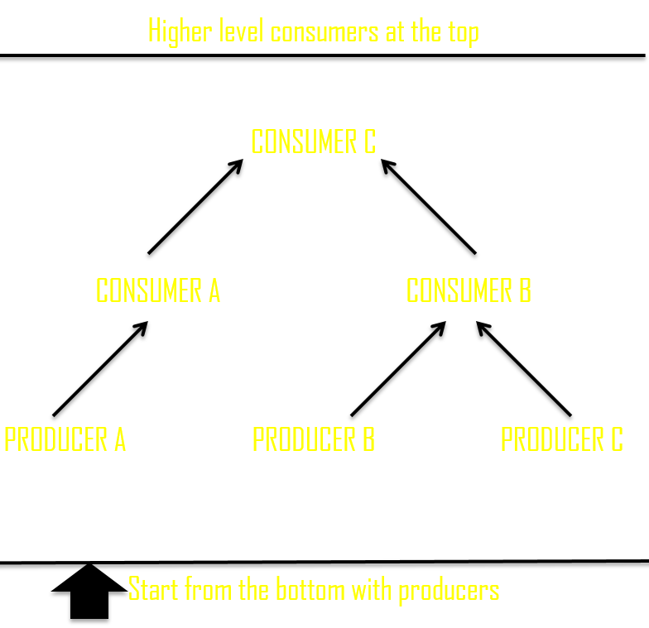
Constructing Food Webs

Slide 4
Crack the Food Web

Slide 5
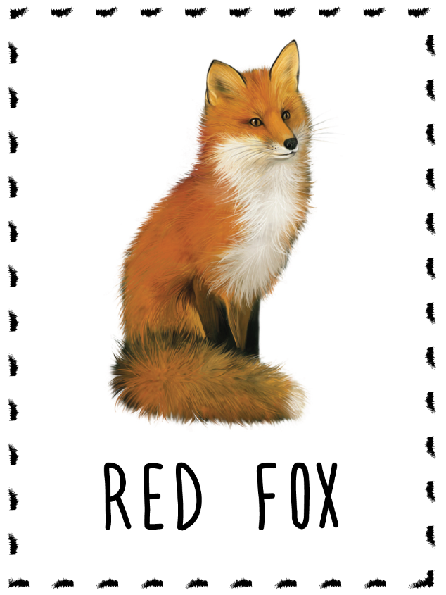
What happens next?
Does the red fox have any natural
predators?
Does the red fox eventually die?
How?
What happens after it dies?

Slide 6
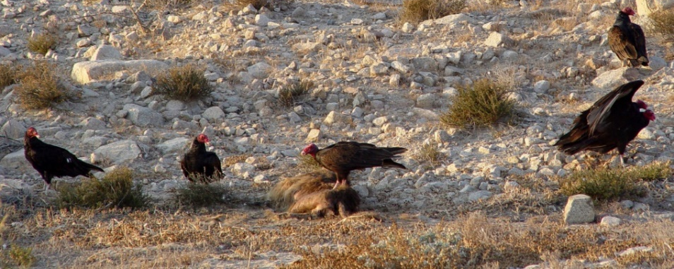
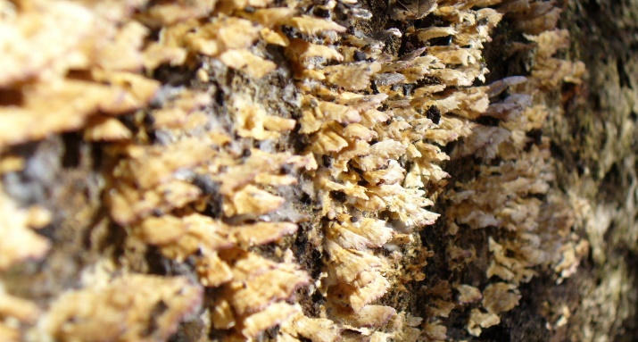
Scavengers VS Decomposers
Scavengers and decomposers break down dead plants and animals.
Scavengers
Scavengers are animals that feed on dead animal or plant matter. Scavengers are carnivores that do not hunt or kill their own prey.
Instead, they find animals that have died of natural causes or
been killed
by other
animals.
DECOMPOSERS
Decomposers are tiny organisms such as bacteria, earthworms and some fungi that eat leftover matter to break it down. They create organic material that is returned to the soil.
If they weren't in the ecosystem, plants would not get essential nutrients, and dead matter and waste would pile up.

