Slide 1
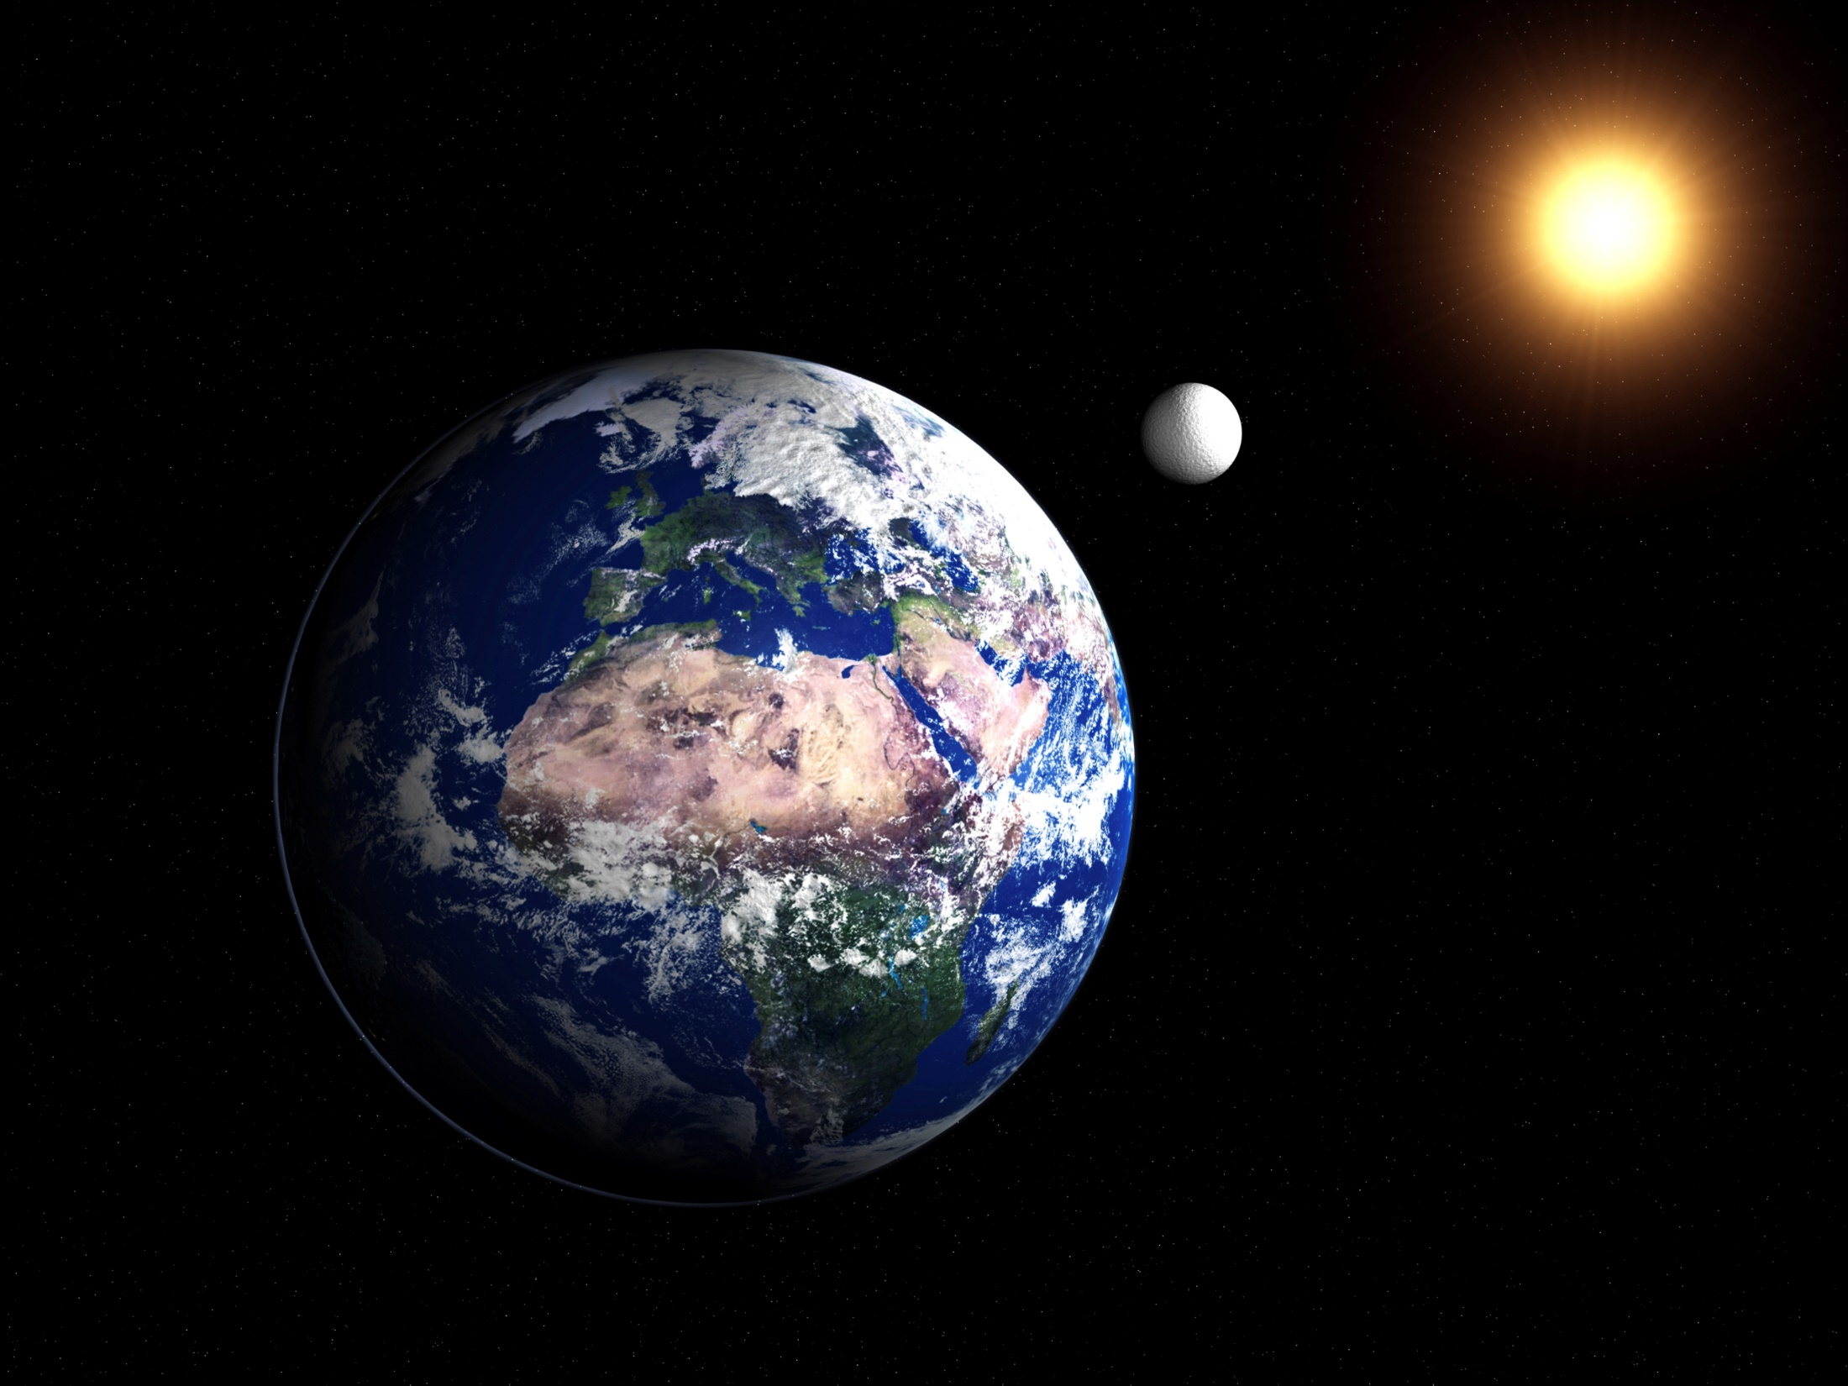
Lightning Writing
LIGHTNING WRITING
What is a satellite?
What is the natural satellite of the Earth?
Why do we have night and day?
Does the moon look the same each night?

Slide 2
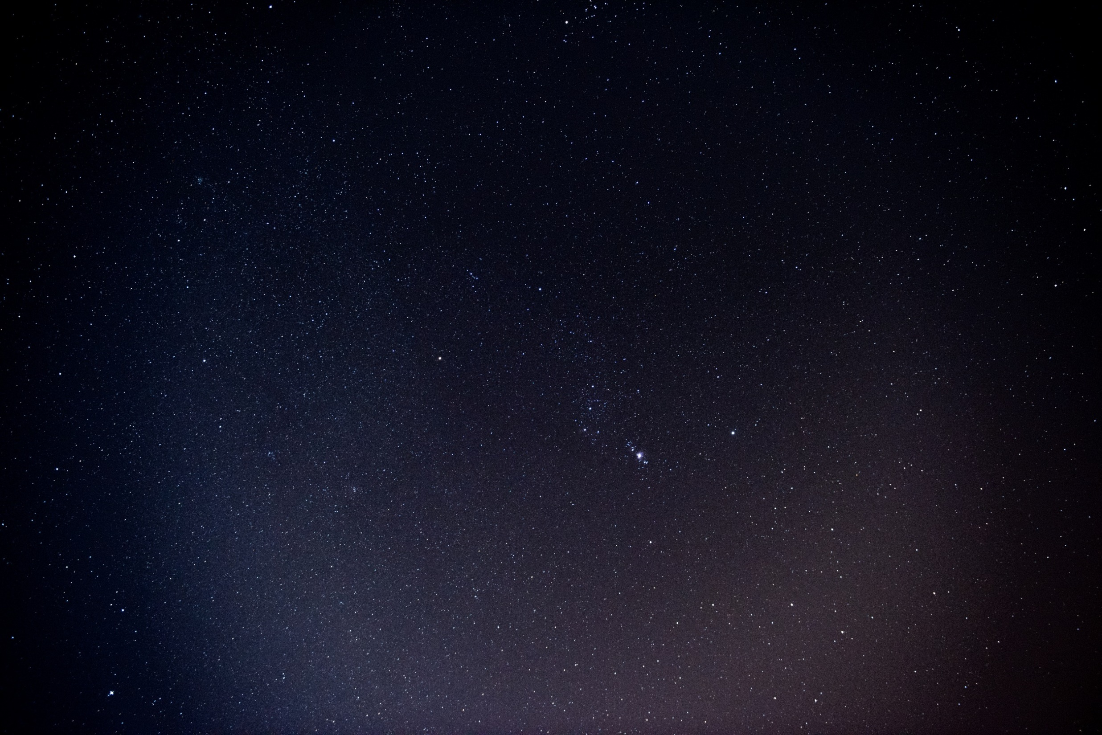
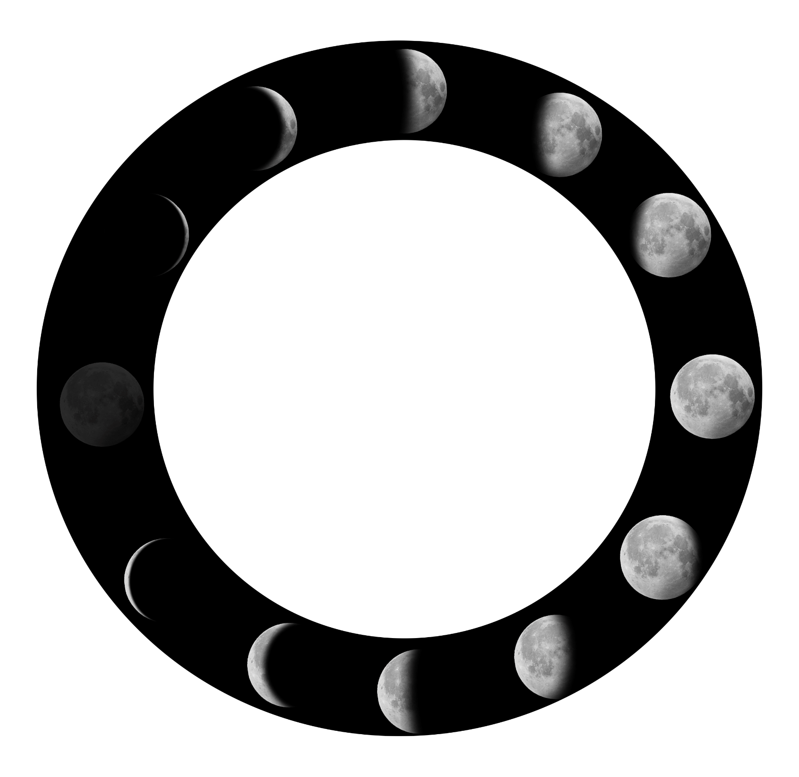
Phases of the Moon
PHASES OF THE MOON

Slide 3
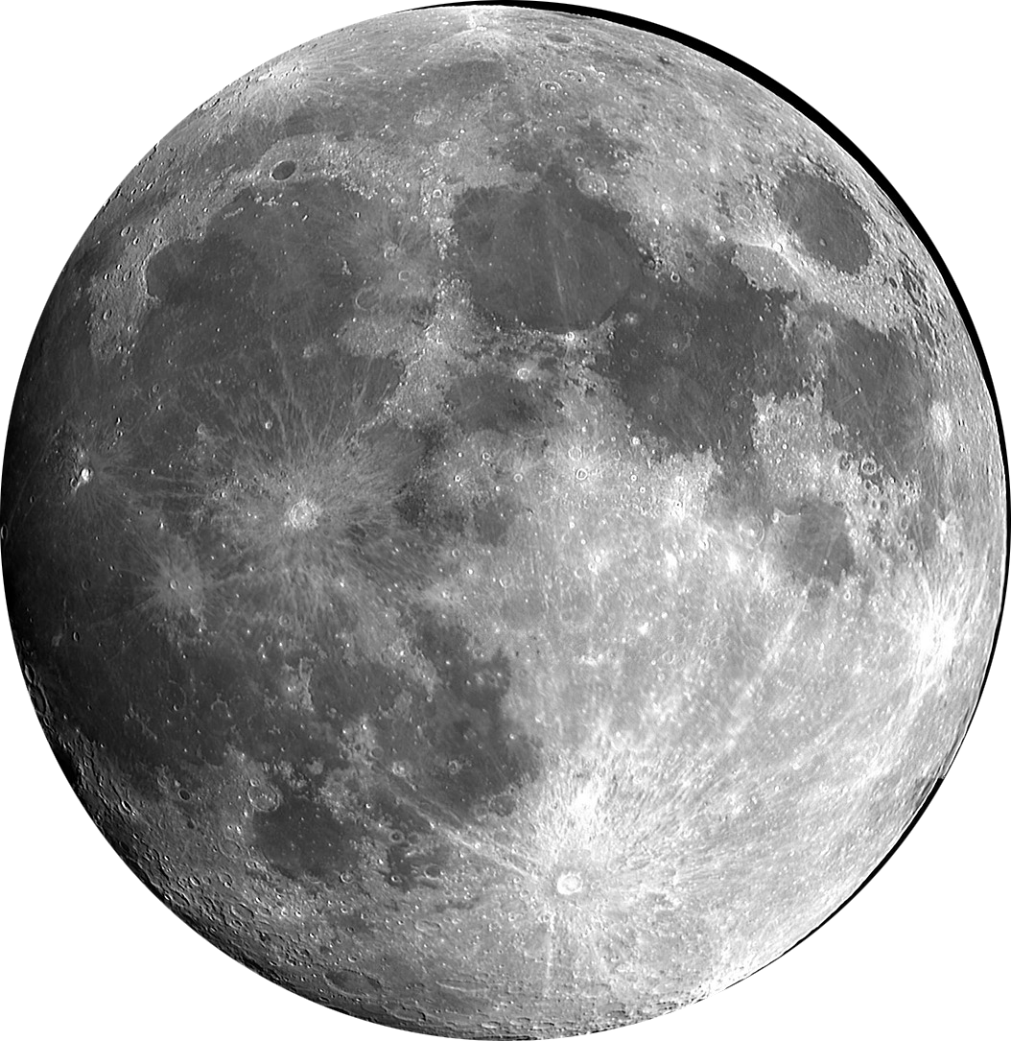


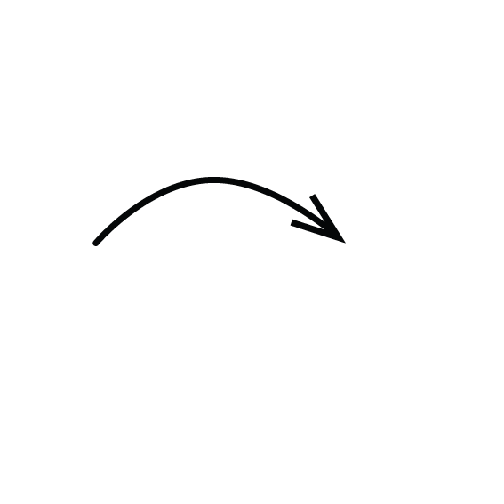

The Moon: Properties
a celestial body orbiting the earth or another planet
natural satellite
THE
MOON
not man-made or artificial
384,400 km
Distance from Earth
Time to orbit around Earth
27.3 days

Slide 4
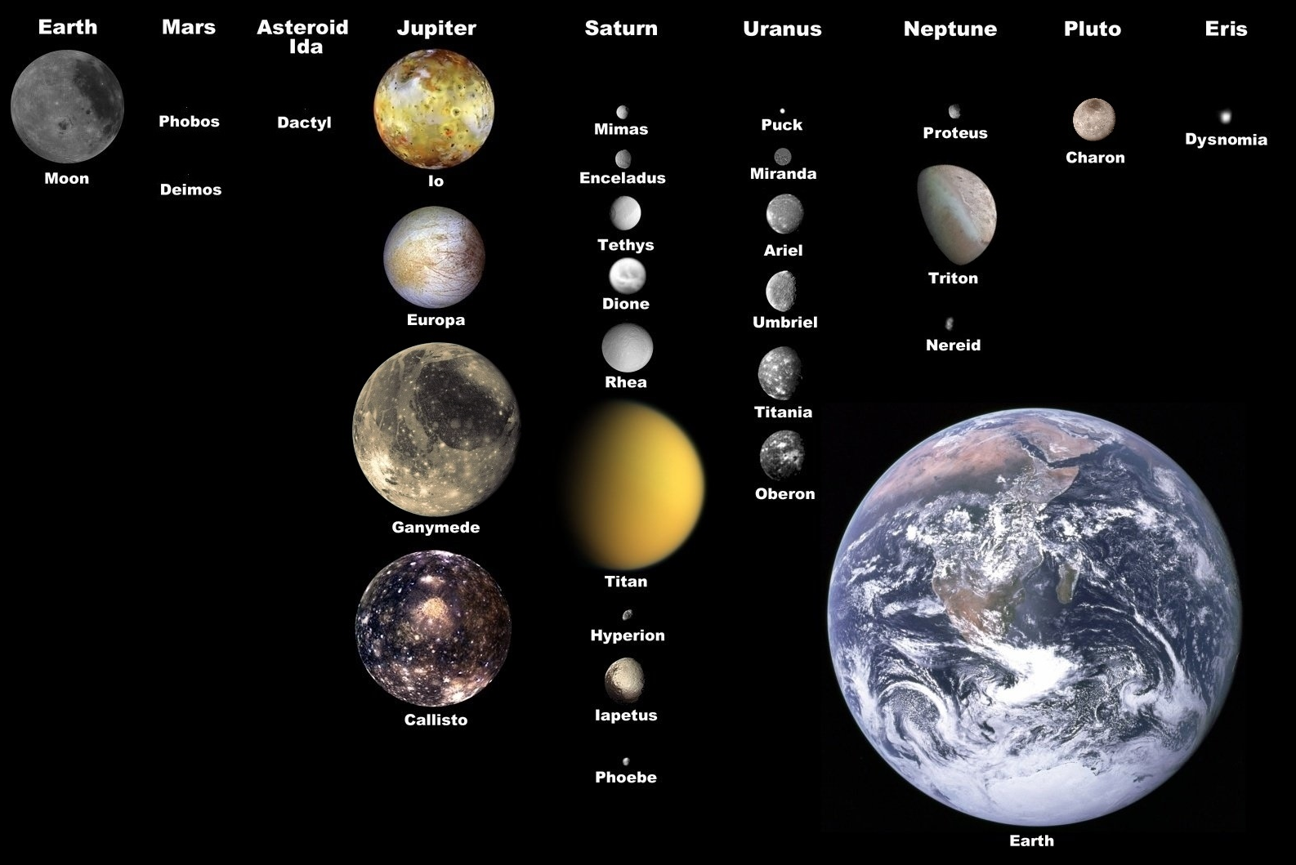
Other Natural Satellites in our Solar System
This diagram shows some examples of natural satellites belonging to other solar bodies.

Slide 5

Phases of the Moon: Properties
Does the Moon produce light of its own?
No, it reflects the light of the Sun.
Then, why do we see the Moon?
Light from the Sun bounces off the Moon and reaches
back to Earth.
Why does the Moon appear differently at times?
The phases of the Moon depend on its position in
relation to the Sun and Earth.

Slide 6
Make your own Moon Wheel!
Let’s make your own
Moon wheel!

Slide 7
Phases of the Moon: Demonstration
Demonstration time

Slide 8
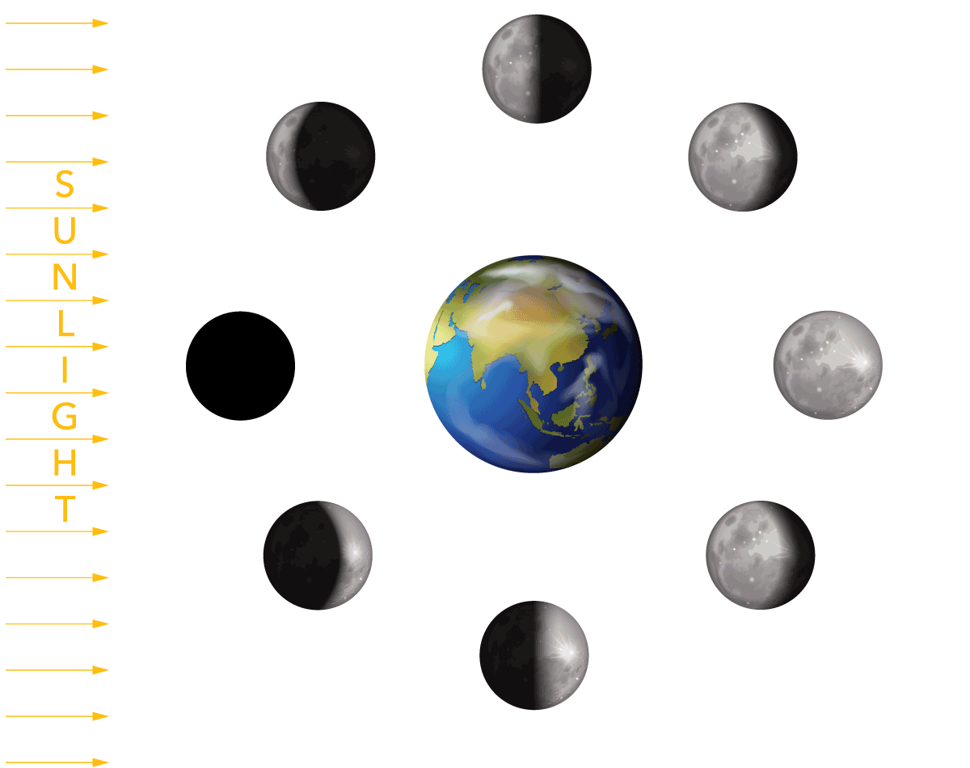
Phases of the Moon: Keywords
waxing
The bright side of the Moon is getting bigger
waning
The bright side of the Moon is getting smaller
gibbous
The bright side of the Moon is larger than
a semicircle and smaller than a circle
crescent
The bright side of the Moon is smaller than
a semicircle

Slide 9
The End
PHASES OF
THE MOON

Slide 10
The End
Fill in the boxes on your bingo card with all 24 words (no repetition) in what ever order you want.
1 | first quarter | 2 | eight | 3 | Sun
4 | new | 5 | third quarter | 6 | counter clockwise
7 | waxing | 8 | smaller | 9 | phases
10 | Moon | 11 | reflects | 12 | orbit
13 | Earth | 14 | full moon | 15 | satellite
16 | side | 17 | crescent | 18 | shape
19 | 27.3 | 20 | gibbous | 21 | 384 400
22 | waning | 23 | visible | 24 | one

